Slide 1
Model Calibration
Day 3

Slide 2
Model Calibration Overview

Slide 3
Motivation
Mathematical models of disease often involve a subset of parameters whose values are unknown
Common reasons include physical, feasibility, and ethical limitations
Estimate values for these parameters by matching model outputs to observed outcomes
Model calibration
Notes:
4

Slide 4
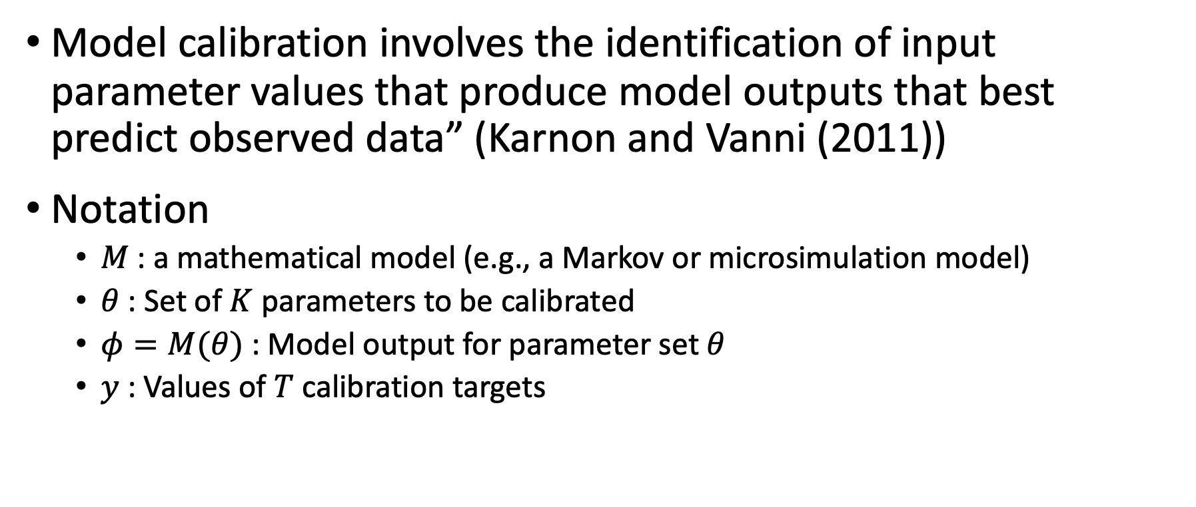
Calibration definition
Model calibration involves the identification of input parameter values that produce model outputs that best predict observed data” (Karnon and Vanni (2011))
Notation
$M$: a mathematical model (e.g., a Markov or microsimulation model)
$θ$: Set of $K$ parameters to be calibrated
$φ=M(θ)$: Model output for parameter set $θ$
$y$: Values of $T$ calibration targets
Notes:
4

Slide 5
Calibration definition
Process of estimating model input parameters to match data on outcomes of interest (e.g., survival, prevalence, or incidence)
Outcomes of interest =
“calibration targets”
Notes:
4

Slide 6
Calibration process
KNOWN PARAMETERS
MODEL
MODEL OUTPUTS
UNKNOWN PARAMETERS
Try different sets of parameter values
Compare against calibration targets
(Calculate “fit”)
Repeat to find “best-fitting”
set of parameter values
Notes:
4

Slide 7
Calibration components
Target data = calibration targets
Goodness-of-Fit (GoF) measures
Search Strategies
Acceptance Criteria
Stopping Rule
Estimation approaches
Notes:
4

Slide 8
Calibration targets
Empirical data to be replicated by the model
Data not used as direct model inputs
Summary statistics (e.g. mean age of cancer diagnosis) or series of observations (e.g. age-specific incidence)
Can calibrate to multiple targets (e.g. survival and prevalence) simultaneously
Model should be able to output the outcomes of interest
Output coverage!
Notes:
4

Slide 9
Goodness-of-fit (GoF)

Slide 10
Calculating “fit”
Goodness-of-Fit (GoF) is the quantitative measure of how well the model is replicating the target data
Different ways to measure GoF
Distance
Likelihood
Notes:
4

Slide 11
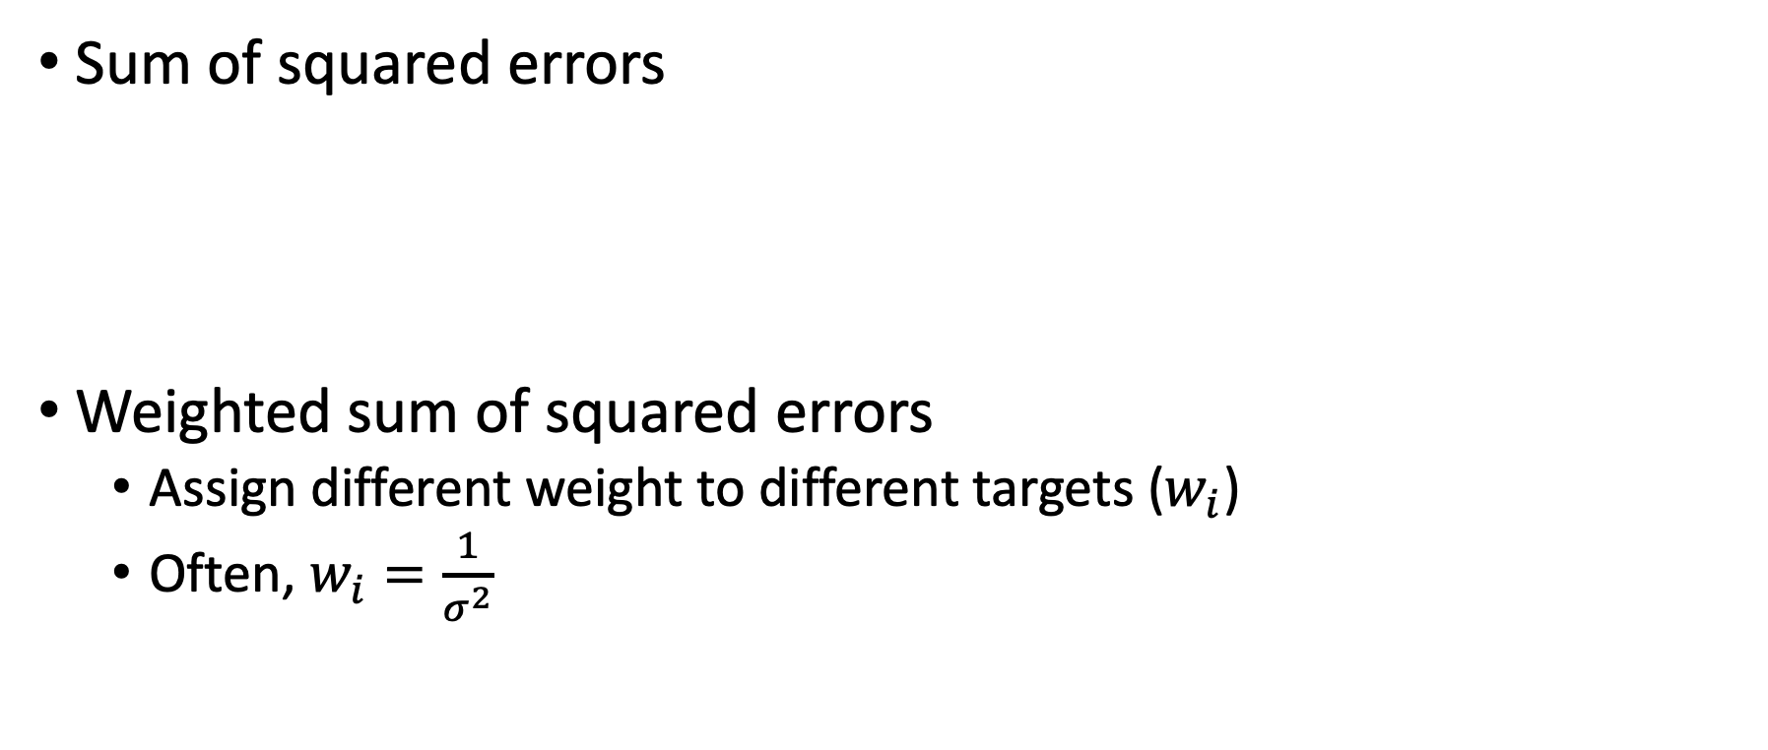
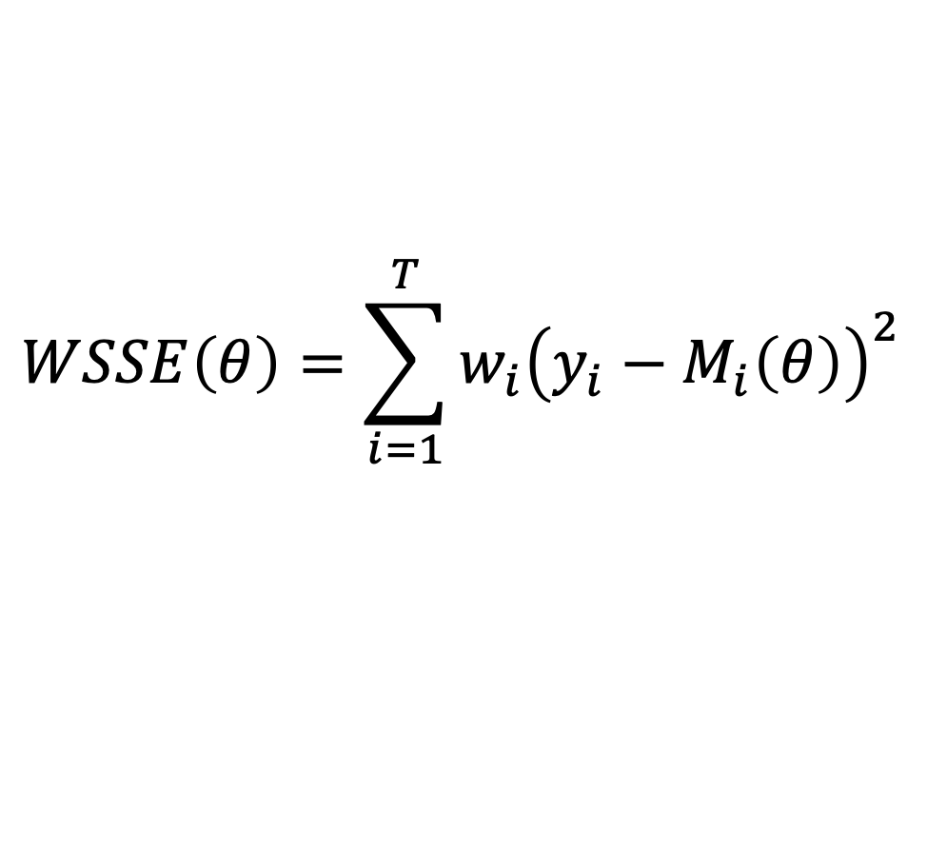
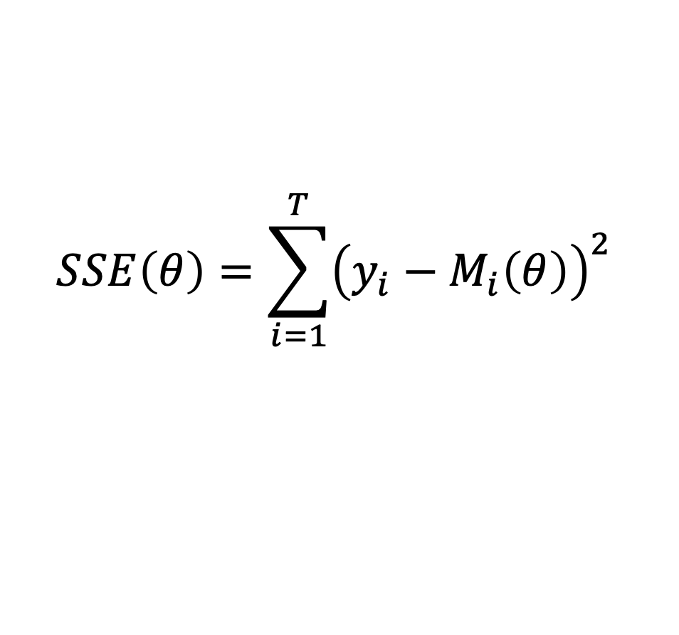
Distance GoF measures
Sum of squared errors
Weighted sum of squared errors
Assign different weight to different targets ($w_{i}$)
Often, $w_{i}=\frac{1}{σ^{2}}$
$$SSE\left(θ\right)=\sum_{i=1}^{T}{{\left(y_{i}−M_{i}\left(θ\right)\right)}^{2} }$$
$$WSSE\left(θ\right)=\sum_{i=1}^{T}{{w_{i}\left(y_{i}−M_{i}\left(θ\right)\right)}^{2} }$$
Notes:
4

Slide 12
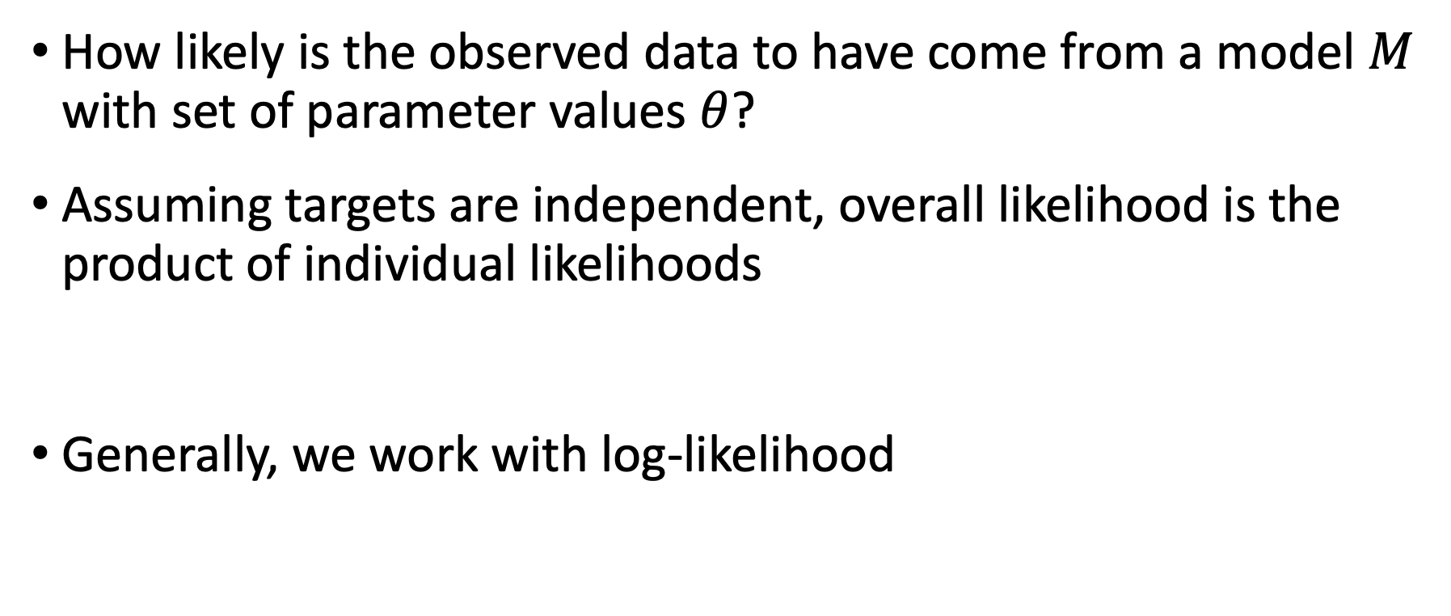
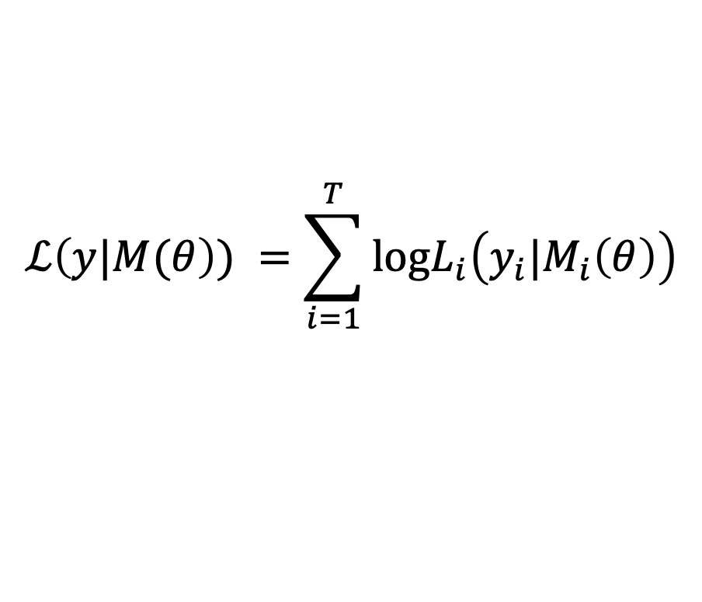
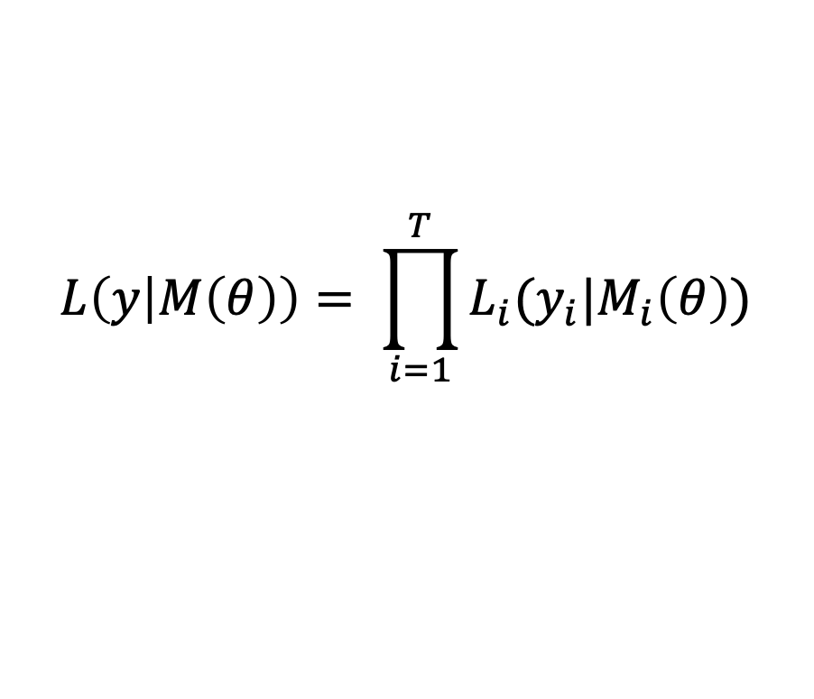
Likelihood as GoF
How likely is the observed data to have come from a model $M$ with set of parameter values $θ$?
Assuming targets are independent, overall likelihood is the product of individual likelihoods
Generally, we work with log-likelihood
$$L\left(y | M\left(θ\right)\right)= \prod_{i=1}^{T}{L_{i}(y_{i}|M_{i}\left(θ\right))}$$
$$ℒ\left(y|M(θ\right)) =\sum_{i=1}^{T}{\text{log}L_{i}\left(y_{i}|M_{i}\left(θ\right)\right)}$$
Notes:
4

Slide 13
Likelihood as GoF
In the case of Normal likelihood with equal variance across targets, MLE yields the same results as minimizing SSE. But if the variance is not equal, MLE is NOT equivalent to minimizing SSE
The variance serves as a weighting factor. The lower the variance, the higher the weight! Why?
Notes:
4

Slide 14
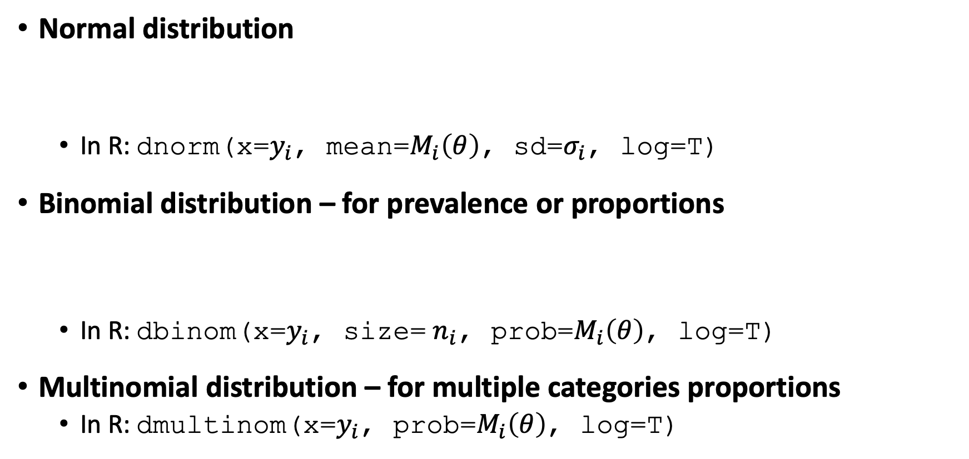
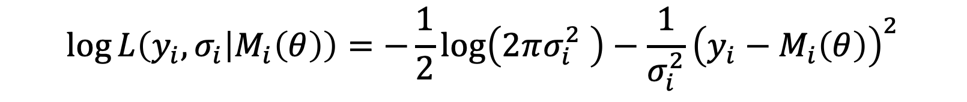
Commonly used likelihoods
Normal distribution
In R: dnorm(x=$y_{i}$, mean=$M_{i}\left(θ\right)$, sd=$σ_{i}$, log=T)
Binomial distribution – for prevalence or proportions
In R: dbinom(x=$y_{i}$, size= $n_{i}$, prob=$M_{i}\left(θ\right)$, log=T)
Multinomial distribution – for multiple categories proportions
In R: dmultinom(x=$y_{i}$, prob=$M_{i}\left(θ\right)$, log=T)
$$\log{L\left(y_{i},σ_{i} | M_{i}\left(θ\right)\right)}=−\frac{1}{2}\log\left(2πσ_{i}^{2} \right)−\frac{1}{σ_{i}^{2}}{\left(y_{i}−M_{i}\left(θ\right)\right)}^{2}$$
$$\log{L\left(y_{i},n_{i} | M_{i}\left(θ\right)\right)}=log\left(\left(\begin{matrix}n_{i} \\ y_{i}\end{matrix}\right)\right){+{ y}_{i}log\left(M_{i}\left(θ\right)\right)}+(n_{i}−y_{i})log\left(1−M_{i}\left(θ\right)\right)$$
Notes:
4

Slide 15
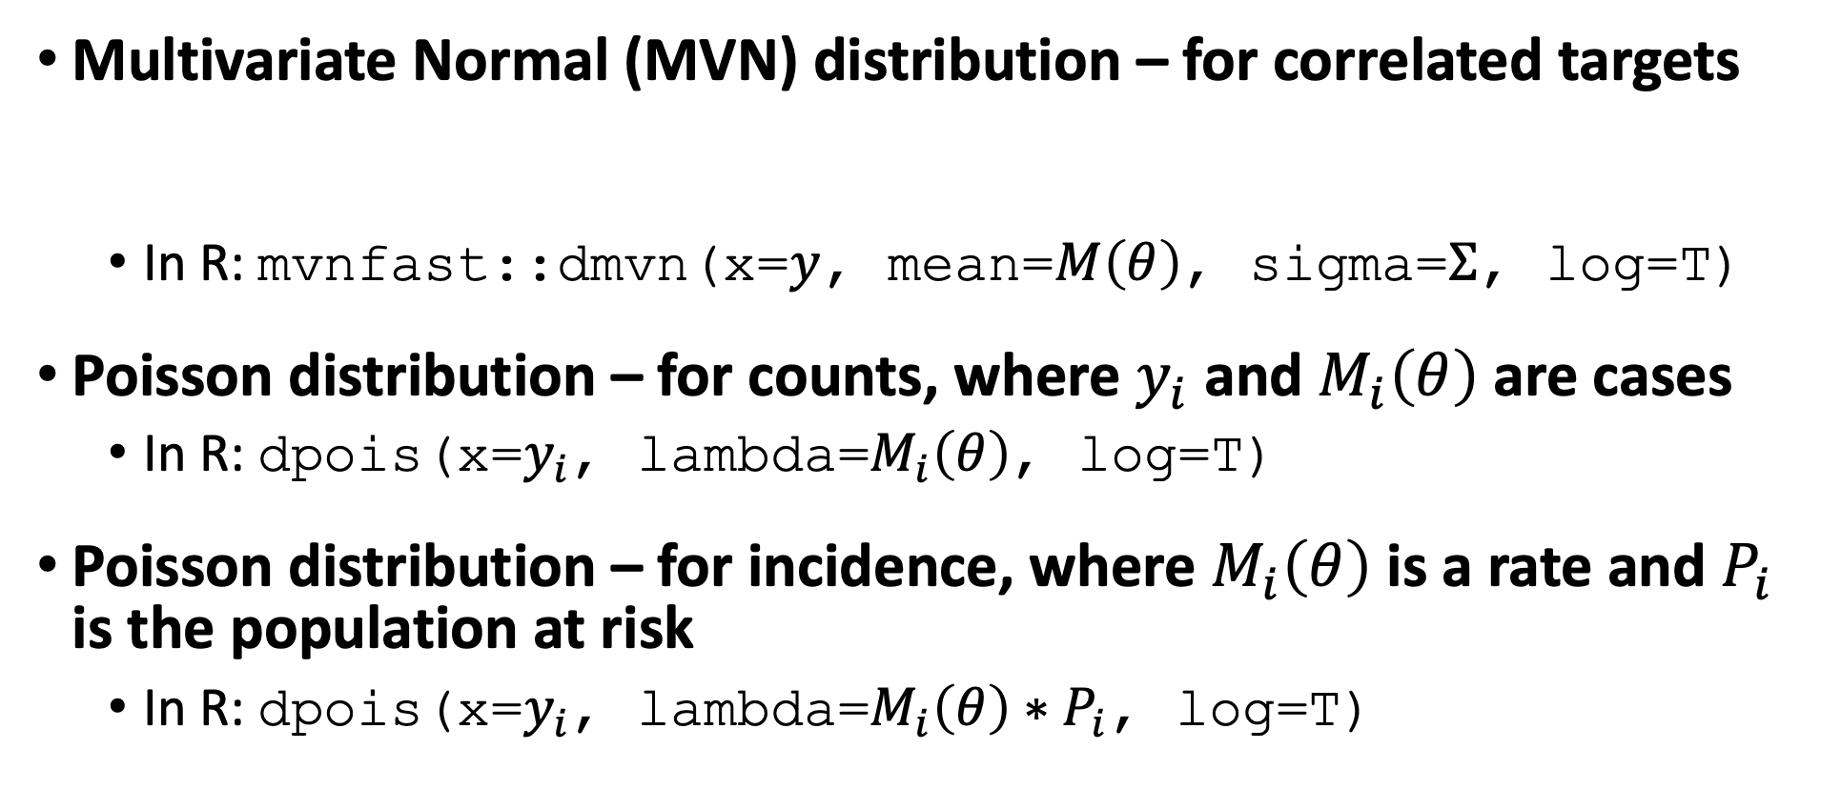
Commonly used likelihoods
Multivariate Normal (MVN) distribution – for correlated targets
In R: mvnfast::dmvn(x=$y$, mean=$M\left(θ\right)$, sigma=$Σ$, log=T)
Poisson distribution – for counts, where $y_{i}$ and $M_{i}\left(θ\right)$are cases
In R: dpois(x=$y_{i}$, lambda=$M_{i}\left(θ\right)$, log=T)
Poisson distribution – for incidence, where $M_{i}\left(θ\right)$ is a rate and $P_{i}$ is the population at risk
In R: dpois(x=$y_{i}$, lambda=$M_{i}\left(θ\right)∗P_{i}$, log=T)
$$\log{L\left(y,Σ | M\left(θ\right)\right)}=−\frac{1}{2}\left[\log\left(\left|Σ\right|\right)+{\left(Y−M\left(θ\right)\right)}^{′}Σ^{−1}\left(Y−M\left(θ\right)\right)+k\log\left(2π\right)\right]$$
Notes:
4

Slide 16
Commonly used likelihoods
Multivariate Normal (MVN) distribution – for correlated targets
In R: mvnfast::dmvn(x=$y$, mean=$M\left(θ\right)$, sigma=$Σ$, log=T)
Poisson distribution – for counts, where $y_{i}$ and $M_{i}\left(θ\right)$are cases
In R: dpois(x=$y_{i}$, lambda=$M_{i}\left(θ\right)$, log=T)
Poisson distribution – for incidence, where $M_{i}\left(θ\right)$ is a rate and $P_{i}$ is the population at risk
In R: dpois(x=$y_{i}$, lambda=$M_{i}\left(θ\right)∗P_{i}$, log=T)
$$\log{L\left(y,Σ | M\left(θ\right)\right)}=−\frac{1}{2}\left[\log\left(\left|Σ\right|\right)+{\left(Y−M\left(θ\right)\right)}^{′}Σ^{−1}\left(Y−M\left(θ\right)\right)+k\log\left(2π\right)\right]$$
Notes:
4

Slide 17
Search Strategies and Algorithms

Slide 18
Search Strategy
Define plausible ranges for parameter whose values are unknown
Use a search strategy to “search” through the input parameter space
Run the model for sets of parameter
values generated by search strategy
Parameter space
Notes:
4

Slide 19
Grid Search
Run model for all possible combinations of parameter values
Often infeasible
Notes:
4

Slide 20
Random Search
Randomly sample a large number of parameter value sets from probabilistic distributions
Use "Latin hypercube sampling”
(LHS) to ensure sample captures
the full parameter space
Random sample
Notes:
4

Slide 21
Random Search
Randomly sample a large number of parameter value sets from probabilistic distributions
Use "Latin hypercube sampling”
(LHS) to ensure sample captures
the full parameter space
LHS sample
Notes:
4

Slide 22
Random Search
Randomly sample a large number of parameter value sets from probabilistic distributions
Use "Latin hypercube sampling”
(LHS) to ensure sample captures
the full parameter space
LHS sample
Best fitting set!
(best GoF)
Notes:
4

Slide 23
Random Search
Randomly sample a large number of parameter value sets from probabilistic distributions
Use "Latin hypercube sampling”
(LHS) to ensure sample captures
the full parameter space
LHS sample
Top 10% best-
fitting sets
Notes:
4

Slide 24
Iterative Search
Use fits of past input values to determine which input values to try next
Directed methods
Nelder-Mead (simplex method)
Gradient–descent and others
Meta-heuristic algorithms
Genetic algorithms
Simulated annealing
Notes:
4

Slide 25
Nelder-Mead Algorithm
Downhill simplex method
It does not require the evaluation of derivatives like the gradient methods, only function evaluation
Pros: Can be used to optimize non-differentiable functions (e.g., simulation models!)

Slide 26
Nelder-Mead Algorithm
Cons: Slower than gradient-based methods
It can get “stuck” in a local critical point. Thus, the algorithm is usually run a few times from different starting points
starting point
final value
search path

Slide 27
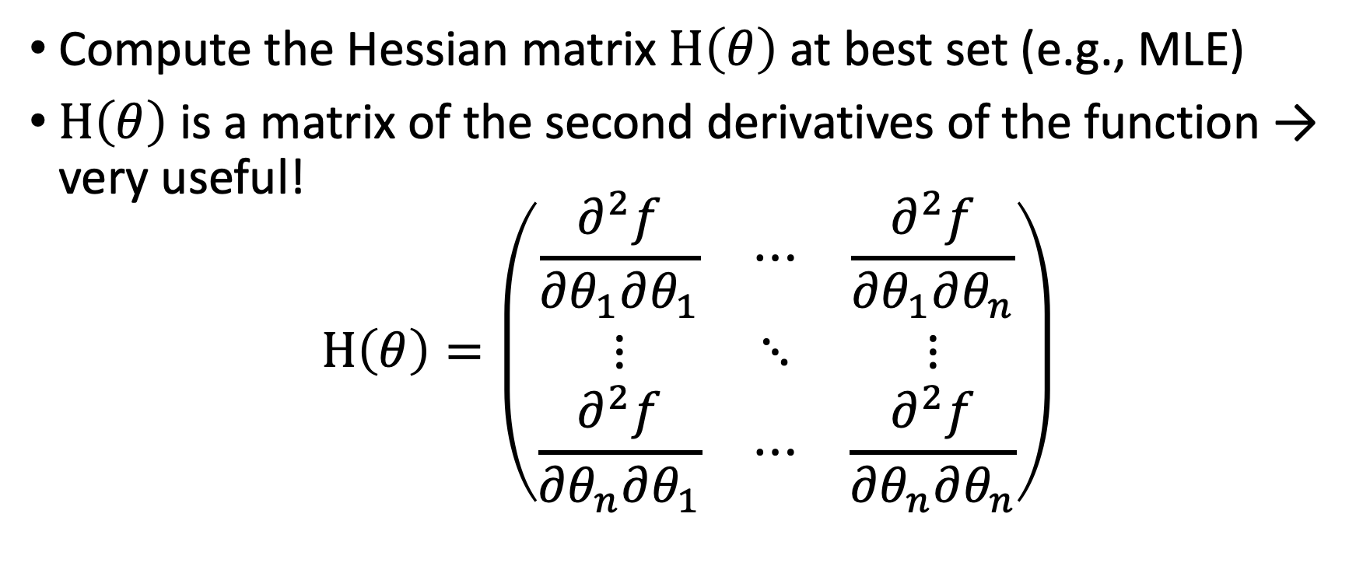
Uncertainty quantification
Compute the Hessian matrix $H\left(θ\right)$ at best set (e.g., MLE)
$H\left(θ\right)$ is a matrix of the second derivatives of the function → very useful!
$$H\left(θ\right)=\left(\begin{matrix}\frac{∂^{2}f}{∂θ_{1}∂θ_{1}} & ⋯ & \frac{∂^{2}f}{∂θ_{1}∂θ_{n}} \\ ⋮ & ⋱ & ⋮ \\ \frac{∂^{2}f}{∂θ_{n}∂θ_{1}} & ⋯ & \frac{∂^{2}f}{∂θ_{n}∂θ_{n}}\end{matrix}\right)$$

Slide 28
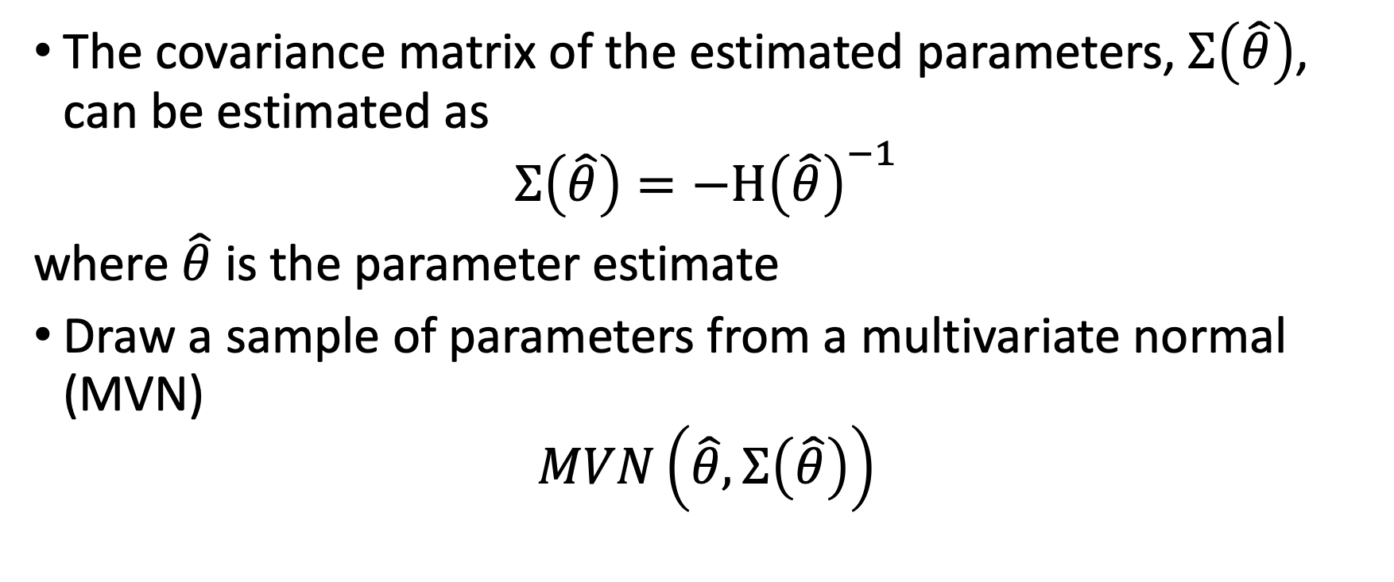
Uncertainty quantification
The covariance matrix of the estimated parameters, $Σ\left(\hat{θ}\right)$, can be estimated as
$$Σ\left(\hat{θ}\right)=−H{\left(\hat{θ}\right)}^{−1}$$
where $\hat{θ}$ is the parameter estimate
Draw a sample of parameters from a multivariate normal (MVN)
$$MVN\left(\hat{θ},Σ\left(\hat{θ}\right)\right)$$

Slide 29
Example: Calibrating a 3-state cancer model

Slide 30
3-state cancer model
Relative survival as reported by the Surveillance, Epidemiology, and End Results (SEER) Program, represents cancer survival in the absence of other causes of death
Cancer Markov models often have a distant metastasis state, a state not directly observed in SEER, from which cancer deaths are presumed to occur
These models are used to model interventions that affect transitions to and from this state
Alarid-Escudero F, MacLehose RF, Peralta Y, Kuntz KM, & Enns, EA. Non-identifiability in model calibration and implications for medical decision making. Medical Decision Making, 2018;38(7):810–21.
Notes:
4

Slide 31
3-state cancer model
Two unknown transition probabilities
p_Mets: Monthly risk of developing distant recurrence, range = [0.04, 0.16]
p_DieMets: Monthly risk of cancer death, range = [0.04, 0.16]
Notes:
4

Slide 32
3-state cancer model
Data frame “CRS_targets$Surv” stored in data file “CRS_CalibTargets.RData”
Notes:
4

Slide 33
Calibration R code template
### Load calibration targets ###
### Load model as a function ###
### Specify calibration parameters ###
### Calibrate ###
### Explore best-fitting input sets ###
Notes:
4

Slide 34
R demonstration lab interlude CALIBRATION

Slide 35
Bayesian Calibration

Slide 36
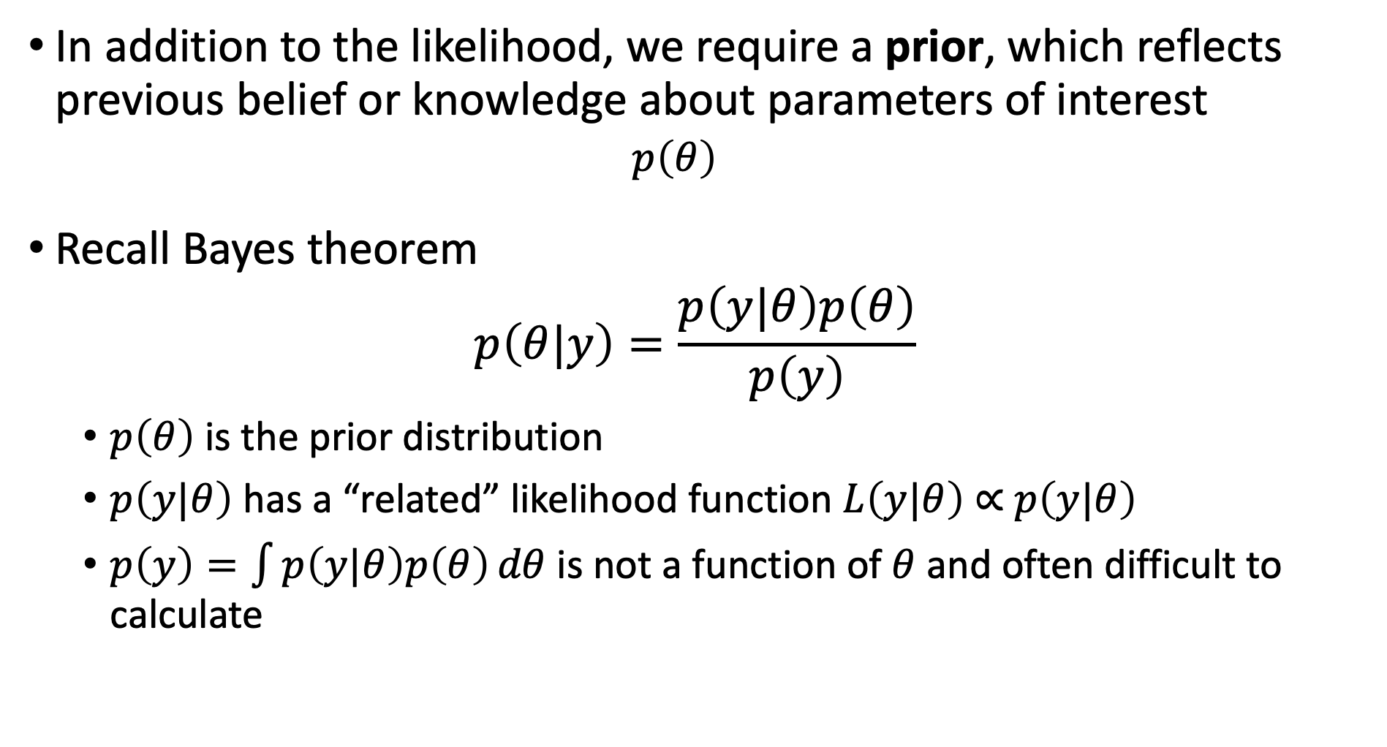
Bayesian setup
In addition to the likelihood, we require a prior, which reflects previous belief or knowledge about parameters of interest
$$p\left(θ\right)$$
Recall Bayes theorem
$$p\left(θ|y\right)=\frac{p\left(y|θ\right)p\left(θ\right)}{p\left(y\right)}$$
$p\left(θ\right)$ is the prior distribution
$p\left(y|θ\right)$ has a “related” likelihood function $L\left(y|θ\right)$ $∝$ $p\left(y|θ\right)$
$p\left(y\right)=\int{p\left(y|θ\right)p\left(θ\right)}dθ$ is not a function of $θ$ and often difficult to calculate

Slide 37
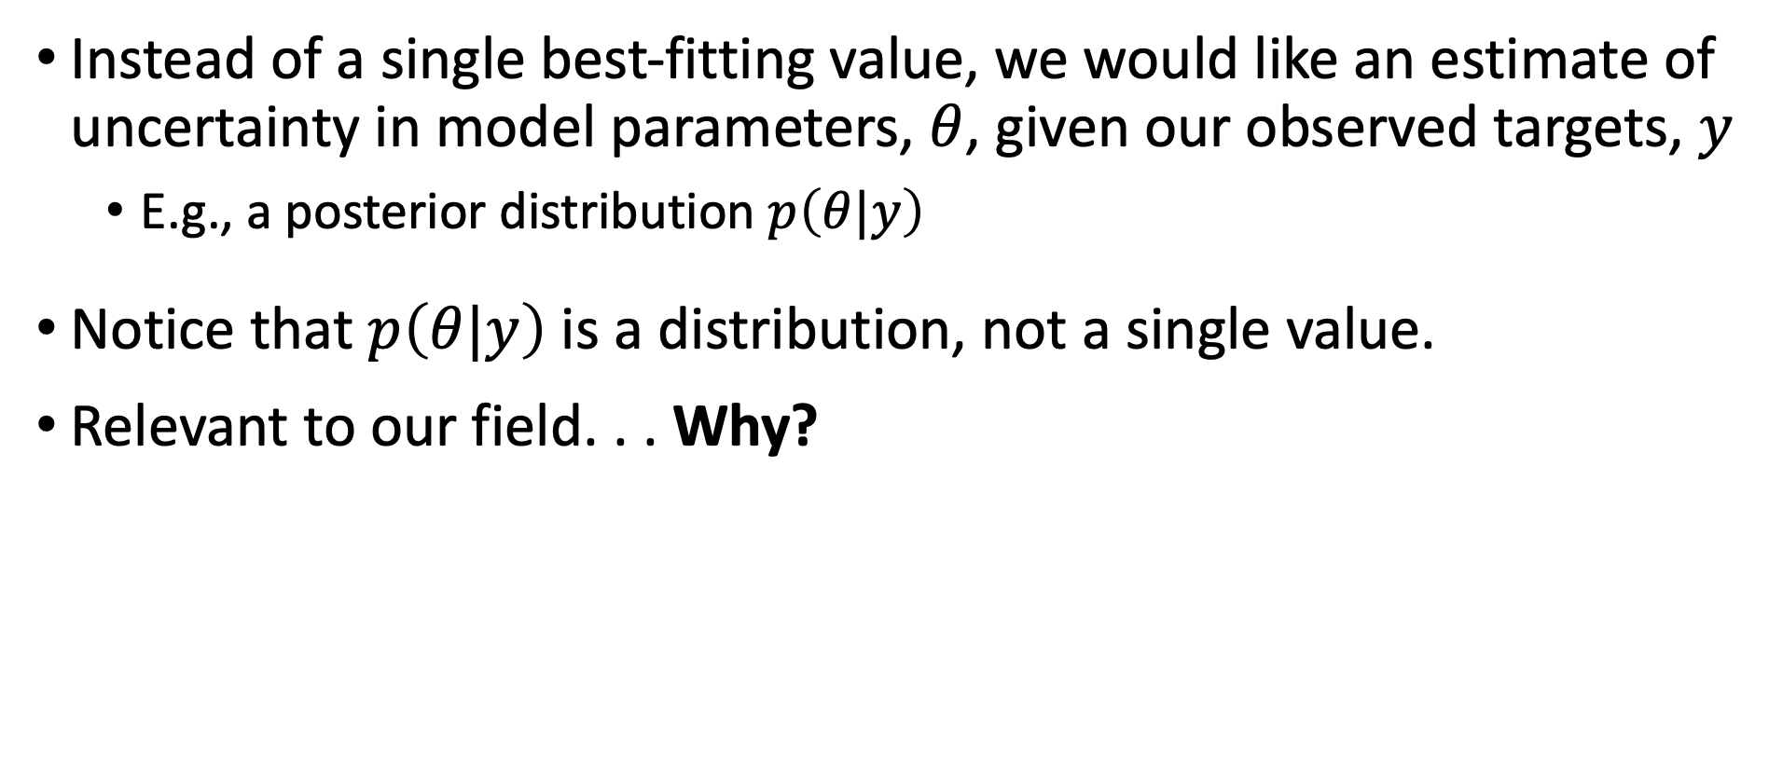
Bayesian setup
Instead of a single best-fitting value, we would like an estimate of uncertainty in model parameters, $θ$, given our observed targets, $y$
E.g., a posterior distribution $p\left(θ|y\right)$
Notice that $p\left(θ|y\right)$ is a distribution, not a single value.
Relevant to our field. . . Why?

Slide 38
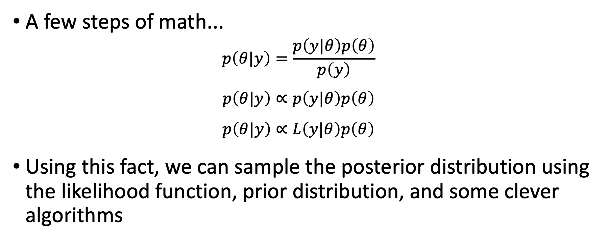
Bayesian setup
A few steps of math...
$$p\left(θ|y\right)=\frac{p\left(y|θ\right)p\left(θ\right)}{p\left(y\right)}$$
$$p\left(θ|y\right)∝p\left(y|θ\right)p\left(θ\right)$$
$$p\left(θ|y\right)∝L\left(y|θ\right)p\left(θ\right)$$
Using this fact, we can sample the posterior distribution using the likelihood function, prior distribution, and some clever algorithms
Notes:
Because the denominator is not a function of θ we can rewrite

Slide 39

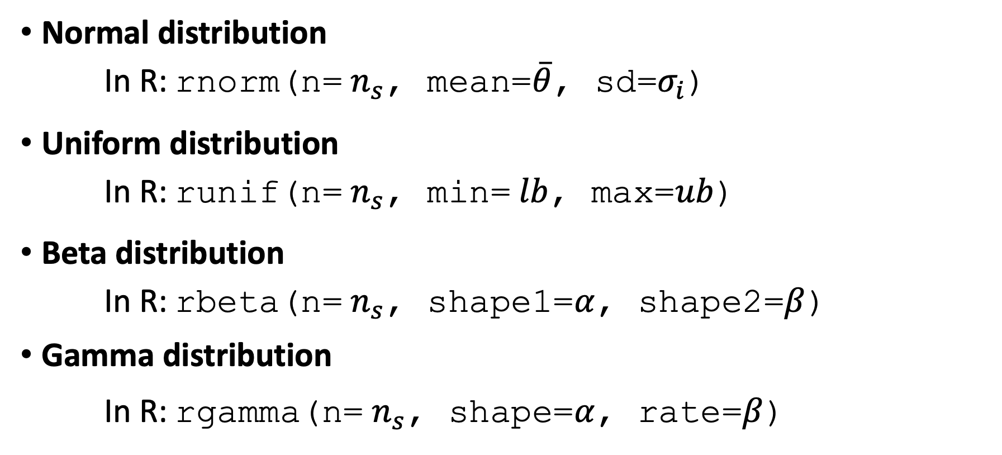
Commonly used prior distributions to sample $n_{s}$ values
Normal distribution
In R: rnorm(n= $n_{s}$, mean=$\overline{θ}$, sd=$σ_{i}$)
Uniform distribution
In R: runif(n= $n_{s}$, min= $lb$, max=$ub$)
Beta distribution
In R: rbeta(n= $n_{s}$, shape1=$α$, shape2=$β$)
Gamma distribution
In R: rgamma(n= $n_{s}$, shape=$α$, rate=$β$)
Notes:
4

Slide 40
Pros and cons
Pros: We obtain distributions of parameters rather than only point estimates
Cons: “Harder” to implement than other methods? Mmm not really!
Notes:
4

Slide 41
Obtaining a posterior distribution
Analytically
Not feasible for simulation models
Markov chain Monte Carlo (MCMC)
Resampling methods
Sampling Importance Resampling (SIR)
Incremental Mixture Importance Sampling (IMIS)
Notes:
4

Slide 42
Markov chain Monte Carlo (MCMC)
Simulates posterior distribution by jumping in the parameter space in a Markovian fashion
The transition matrix of the Markov chain is obtained from a proposal distribution
There are numerous algorithms that implement MCMC, including Metropolis-Hastings (MH)
R has some packages that implement MCMC algorithms
Other R packages interface with external MCMC software, including WinBUGS, JAGS, and stan
Notes:
4

Slide 43
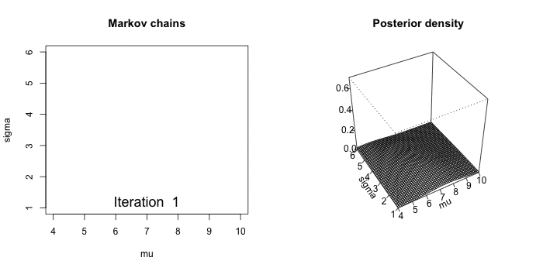
Markov chain Monte Carlo (MCMC)
Notes:
4

Slide 44
Markov chain Monte Carlo (MCMC)
Pros:
Theoretically will eventually converge to the “true” posterior distribution
Cons:
Computationally intensive
Autocorrelation is a problem with simulation models and therefore requires a high number of samples
Use of external software (WinBUGS, JAGS, stan), requires implementing the model within that software’s syntax
Notes:
4

Slide 45
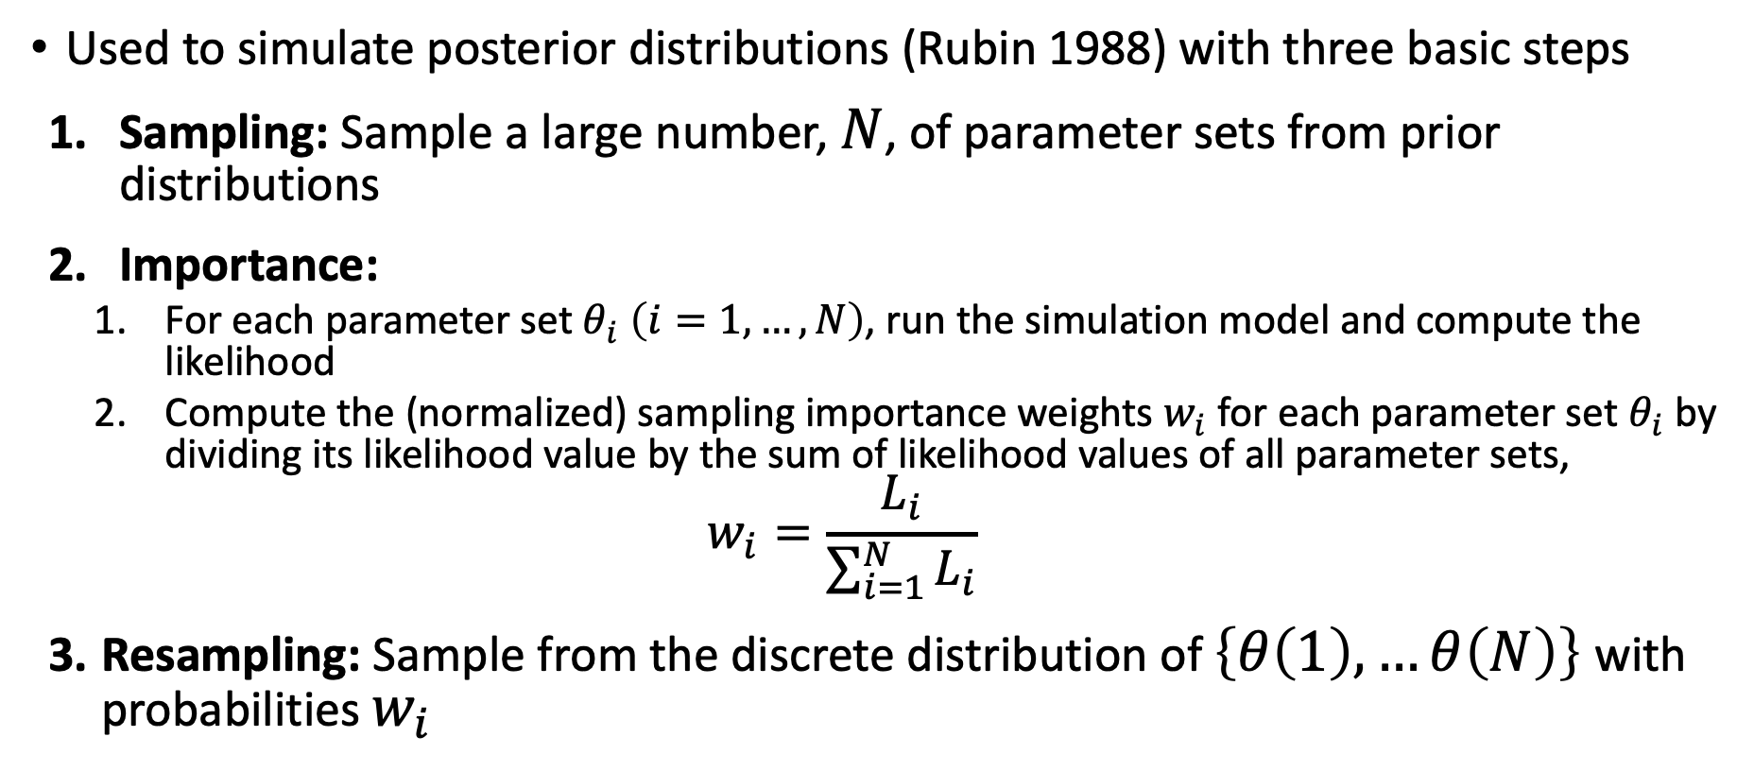
Sampling Importance Resampling (SIR)
Used to simulate posterior distributions (Rubin 1988) with three basic steps
Sampling: Sample a large number, $N$, of parameter sets from prior distributions
Importance:
For each parameter set $θ_{i}$ $\left(i=1,…,N\right)$, run the simulation model and compute the likelihood
Compute the (normalized) sampling importance weights $w_{i}$ for each parameter set $θ_{i}$ by dividing its likelihood value by the sum of likelihood values of all parameter sets,
$$w_{i}=\frac{L_{i}}{\sum_{i=1}^{N}{L_{i}}}$$
Resampling: Sample from the discrete distribution of $\left\{θ\left(1\right), …θ\left(N\right)\right\}$with probabilities $w_{i}$
Notes:
4

Slide 46
Incremental Mixture Importance Sampling (IMIS)
SIR can miss areas of high posterior probability as the number of parameters increases
IMIS addresses the limitations of SIR and was proposed by Steele et al. (2006)
Starts with a modest-size SIR
But in addition to SIR samples, add in samples from a mixture of multivariate normal distribution centered at the point with the highest importance weight
Recalculate importance weights and sample a new sample of input parameter sets
In the end, the posterior becomes a mixture of multivariate normal distributions and the prior distribution
Notes:
4

Slide 47
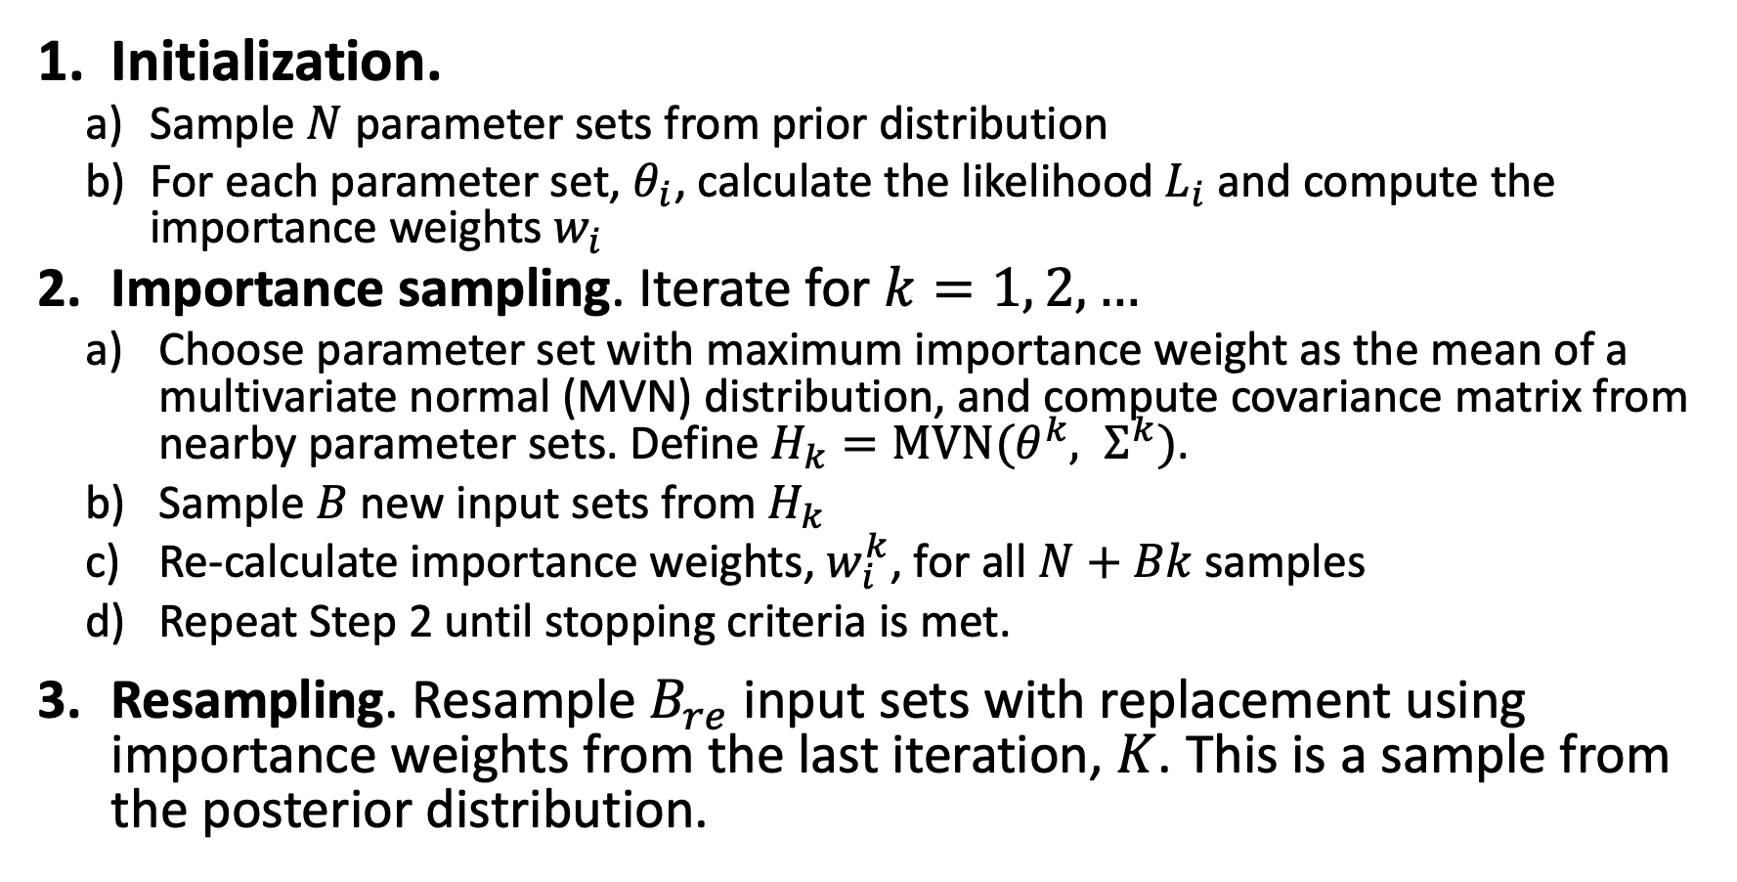
Incremental Mixture Importance Sampling (IMIS)
Initialization.
Sample $N$ parameter sets from prior distribution
For each parameter set, $θ_{i}$, calculate the likelihood $L_{i}$and compute the importance weights $w_{i}$
Importance sampling. Iterate for $k=1, 2, …$
Choose parameter set with maximum importance weight as the mean of a multivariate normal (MVN) distribution, and compute covariance matrix from nearby parameter sets. Define $H_{k}=\text{MVN}(θ^{k}, Σ^{k})$.
Sample $B$ new input sets from $H_{k}$
Re-calculate importance weights, $w_{i}^{k}$, for all $N+Bk$samples
Repeat Step 2 until stopping criteria is met.
Resampling. Resample $B_{re}$ input sets with replacement using importance weights from the last iteration, $K$. This is a sample from the posterior distribution.
Notes:
4

Slide 48
Incremental Mixture Importance Sampling (IMIS) Outputs
resamples: B.re draws from the posterior distribution
stat: diagnostic statistics at each IMIS iteration
MargLike:
UniquePoint: expected number of unique points among resamples
MaxWeight: maximum importance weight
ESS: effective sample size (the closer to B.re, the better)
center: center of Gaussian components
Notes:
4

Slide 49
R demonstration lab interlude CALIBRATION

